Slide 1
DAB402 – Capstone Project PATENT MODELLING(APPROVAL TIMELINE PREDICTION)
BY GROUP-6

Slide 2
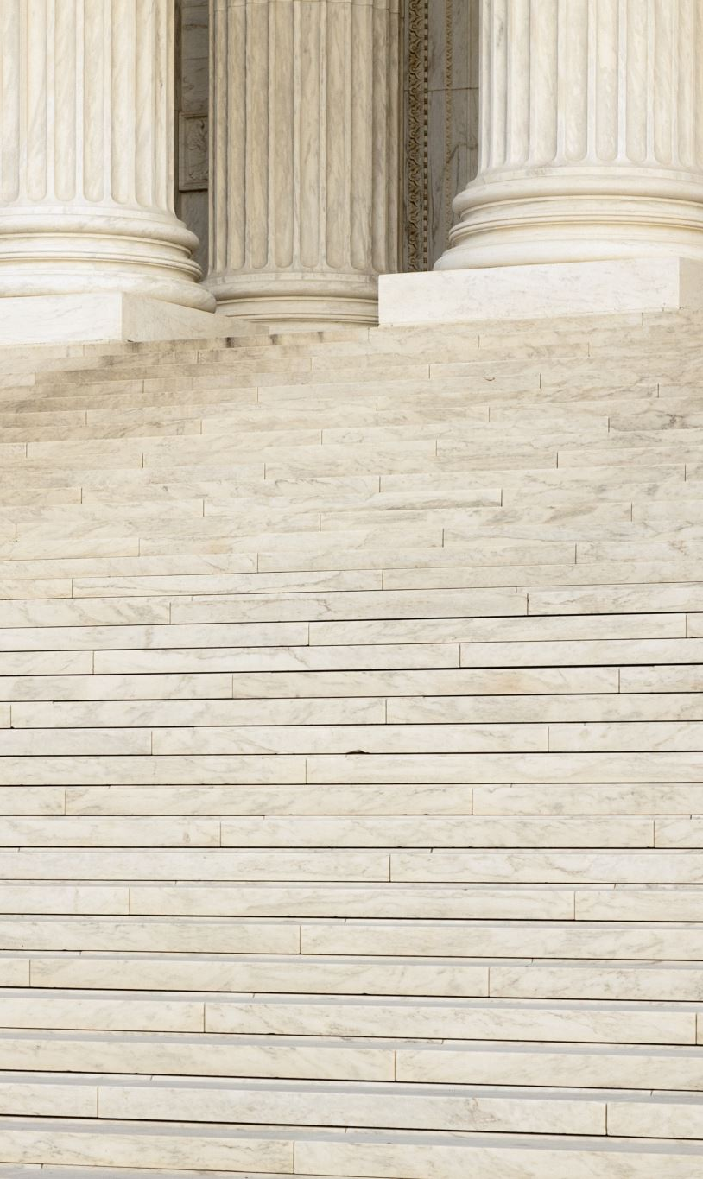
Team Introduction
Manoj Kumar Ravindranath
Sai Sowmith Komakula
Srilekhya Byreddi
Elda Maria Thomas
Sreenatha Reddy Ramireddy

Slide 3

Presentation contents
About The Company
Patent Filing
Patent Filing Process Flow
Business Problem
Business Objective
Existing Model
Dataset
Feature Description
Understanding The Data
Correlation Matrix
Hypothesis
Mathematical Model
Deep Learning Model
Conclusion

Slide 4

About the company:
They have been involved in various industries such as.
Education
Healthcare
Polymer Science and
Engineering and Technologies
They have been involved in various projects such as.
Smart decisions during critical illness
Genetic & lifestyle contributions to excessive Visceral Fat Accumulation (VFA) related Illnesses
Gamification Strategy For Improved User Comprehension
Documentation Authentication System

Slide 5
Patent Filing
Filing a patent refers to the process of submitting a patent application to the appropriate government agency, such as the United States Patent and Trademark Office (USPTO) in the United States or the European Patent Office (EPO) in Europe.
A patent application is a legal document that describes an invention in detail and outlines the claims that the inventor is seeking to protect.
When you file a patent application, you are essentially requesting that the government grant you the exclusive right to manufacture, use, and sell your invention for a certain period of time, typically 20 years from the filing date.
In exchange for this exclusive right, you must fully disclose your invention in the patent application so that others can learn from it and potentially improve upon it once the patent expires.

Slide 6
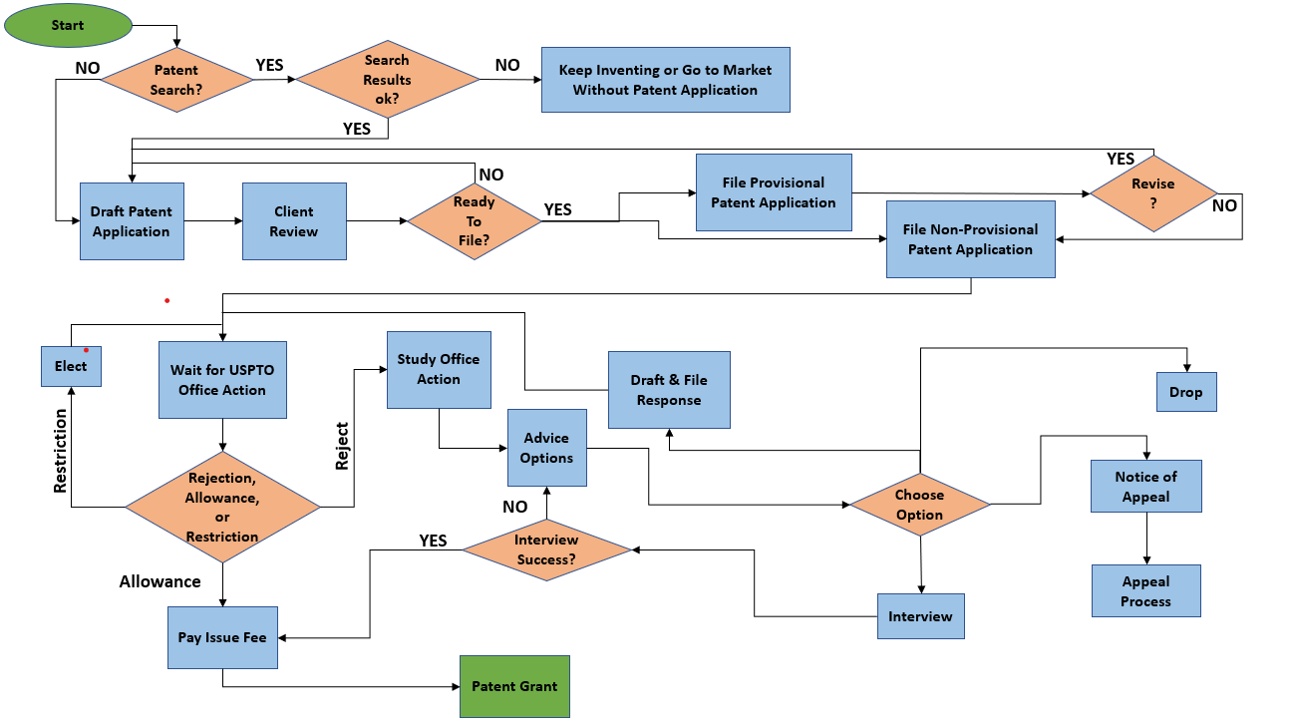
Patent Filing Process Flow

Slide 7
Business Problem
It is tedious process when the companies have to plan and forecast the resources and budget required for the patent application process.
By having a more accurate prediction of the patent acceptance timeline, companies and patent offices can allocate their resources more effectively and prioritise their workload accordingly.
It also allows them to plan their product launches and commercialization strategies more effectively.
The traditional method of predicting the timeline of patent acceptance is manual, time-consuming, prone to human error, and often lacks accuracy.
This leads to inefficiencies in the patent application process and can result in significant financial losses for companies and patent offices.

Slide 8
Business Objective
The objective is to develop a machine-learning-based solution that can accurately predict the timeline of the patent acceptance process, improving the efficiency and reliability of the patent application process, and reducing the potential for errors and delays.
The project will involve collecting and analysing data related to patent applications, including historical data on patent acceptance timelines and relevant contextual information.
The data will be used to train and validate machine learning algorithms that can accurately predict the patent acceptance timeline.

Slide 9
Existing Model
Some organisations use manual methods such as manual tracking, spreadsheets, and calendars to predict the timeline of patent acceptance.
There are several commercial software tools, like Patent Wizard , that will assist you in writing like a patent attorney if you are dedicated to writing your own patent application.
Machine learning is increasingly being used in the patent industry for tasks such as prior art search, patent classification, and analysis of patent landscapes, but currently there is no system to predict the timeline of acceptance.
The best solution for a particular organisation will depend on the organization's specific needs and resources, as well as the project's goals.
Traditional methods could be time-consuming and prone to human error.
Incorporation of predictive models based on machine learning algorithms, such as artificial neural networks, decision trees, and random forests, can be used to predict the timeline of patent acceptance by analysing historical data on patent applications and their outcomes.

Slide 10
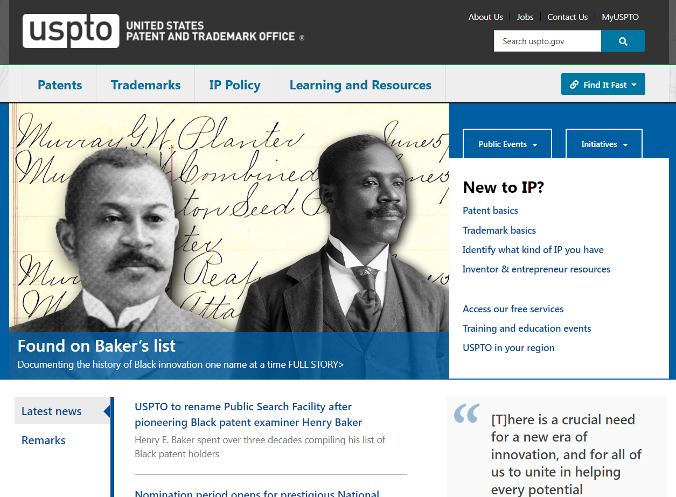
Dataset:
The USPTO website (United States Patent and Trademark Office) will be used to extract the data.
The extracted data will be organized into a structured database.
Web scrapping technology will be used to scrape the data from USPTO website.
Data handling techniques to maintain the quality of data will be in place.
Measures will be taken to protect the privacy and security of the data, such as using secure methods for data storage and management.

Slide 11
Feature Description:
Title | Title of the invention / the patent that one is filing
Earliest Priority date | The earliest priority date in a patent filing application is the date on which the first application for a particular invention was filed
Application date | The date when the patent was filed
Publication kind code | Publication Kind Code is a code used to indicate the type of patent document that has been published by a patent office
Assignee/ Applicant | An applicant in a patent filing application is the person or entity who files the patent application with the relevant patent office
IPC/CPC class | IPC (International Patent Classification) and CPC(Cooperative Patent Classification) are two systems of classification used to categorize patents and patent applications based on their technical subject matter
Abstract | an abstract is a brief summary of the invention
Claims count | Number of claims made in a patent
Inventor count | Number of inventors for an invention
Publication date | The date when the patent was approved
Count of cited ref | Number of references made in an application
Count of Citing | Number of times this application was referenced in other patents

Slide 12
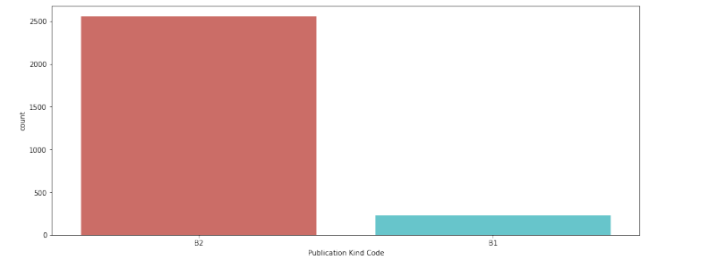
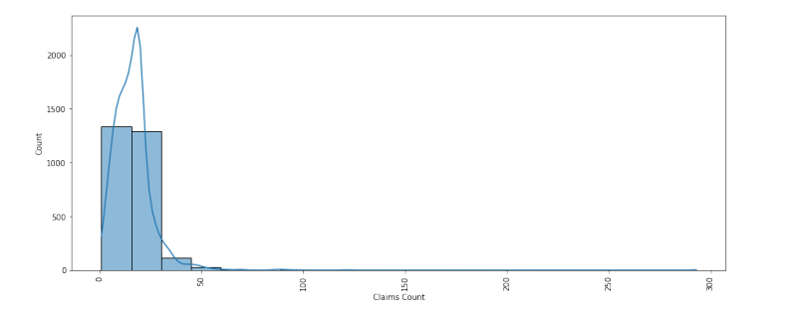
Understanding The Data:
Application Type
Claims Count
From the above graph the number of B2 application is clearly higher than B1 application.
Clearly the average number of claims that was made is around 25 to 30, in very few scenarios the claims count has crossed 100.

Slide 13
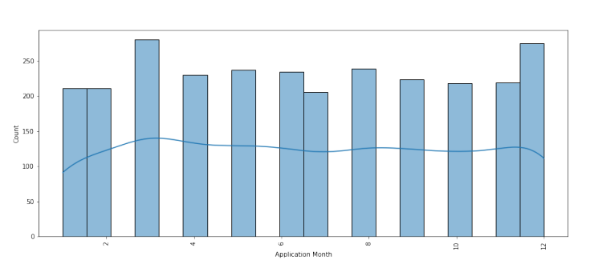
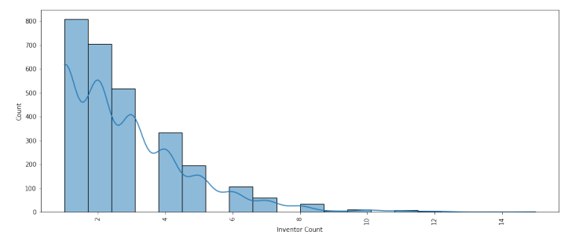
Understanding The Data:
Inventor Count
Application Month
The inventor count in most of the patent application is 1
From the graph it is obvious that the month that has seen the highest number of application is March and December with the rest of the months sharing almost the same number of applications

Slide 14
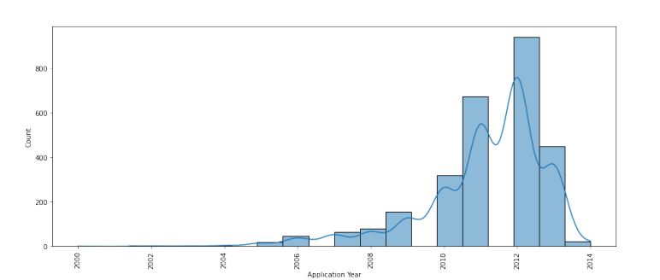
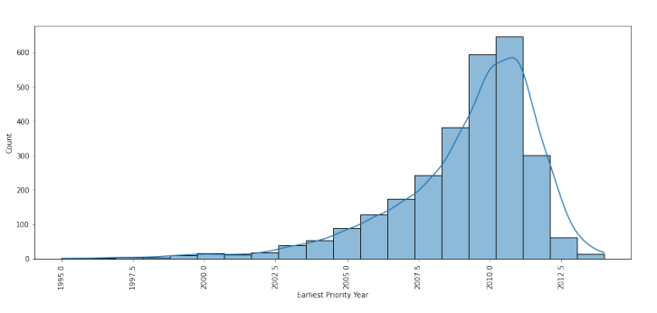
Understanding The Data:
Application Year
Earliest Priority Year
For this study we have taken the patent applications that were approved in the year 2014. From the graph it is clear that most of the patent were filed in the year 2012.
Most of the patents has their earliest priority year as 2010 and 2011.

Slide 15
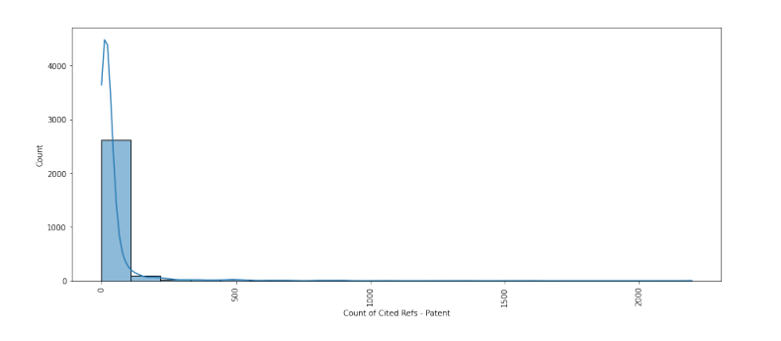
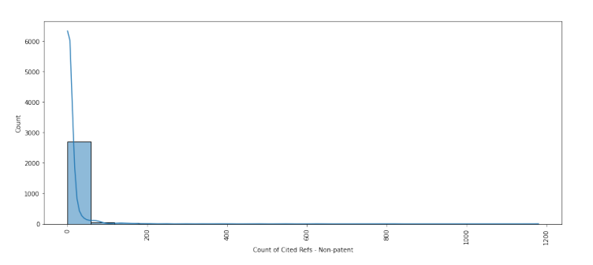
Understanding The Data:
Count of Cited Ref’s - Patent
Count of Cited Ref’s – Non-Patent
Almost 90% of the patent application has less than 100 cited references.
The number of cited patent reference and the number of cited ref- Non patent is almost same in most of the application.

Slide 16
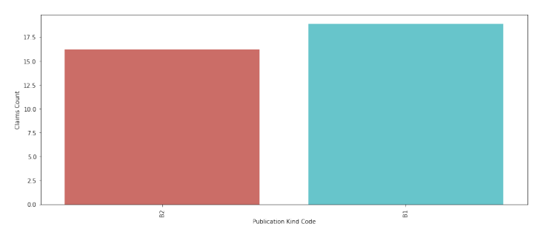
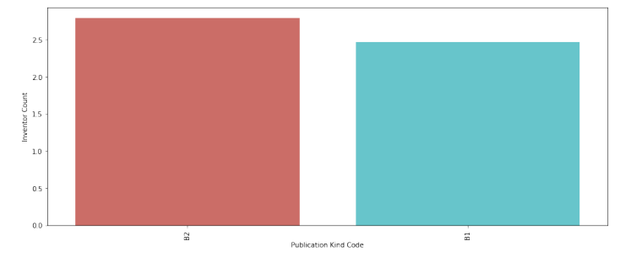
Understanding The Data:
Publication Kind Code vs Claims Count
Publication Kind Code vs Inventor Count
The average number of claims made in the B1 application is higher than the B2 application
With regards to the inventor count B2 application has more number of inventors.

Slide 17
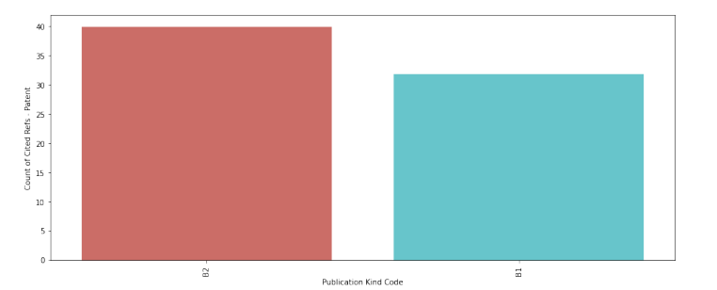
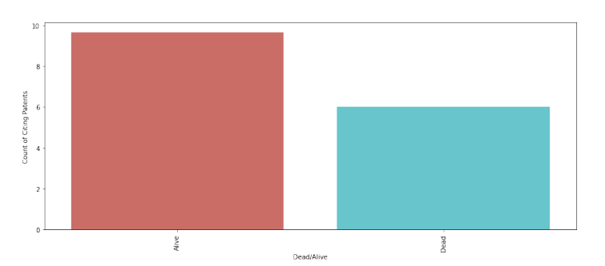
Understanding The Data:
Publication Kind Code vs Count of Cited Ref’s - Patent
Dead/Alive vs Count of Citing Patents
The count of Cited ref-Patent and Cited ref-Non patent is higher in B2 application which also means in general the number of references cited in B2 type application is higher that B1 application.
The count of the patents which has status as Alive are more compared to the Dead.

Slide 18
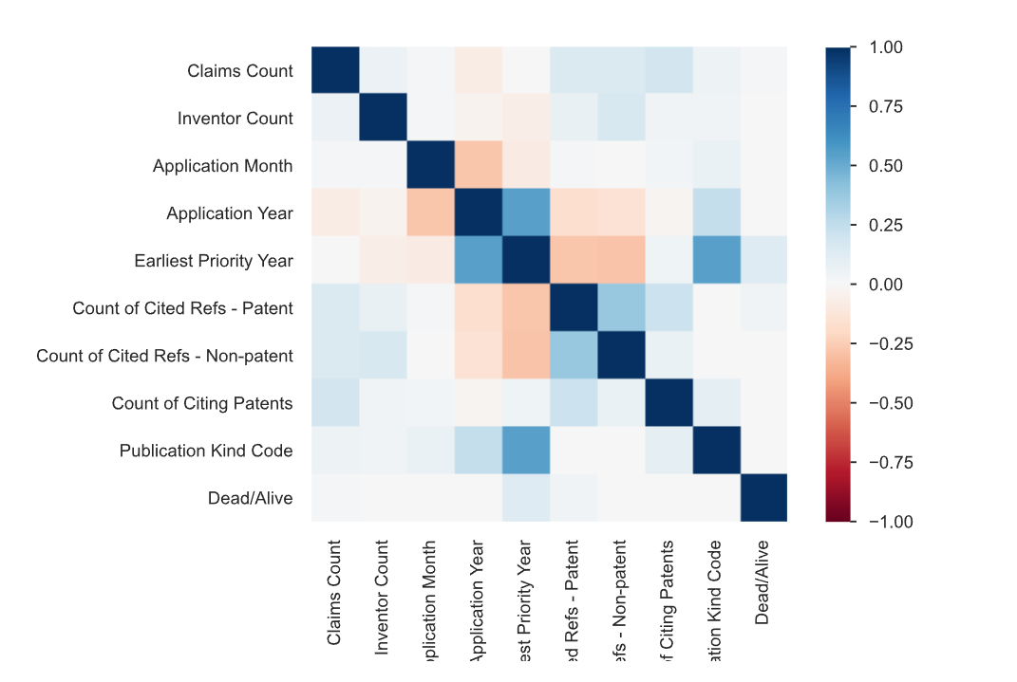
Correlation Matrix

Slide 19
Hypothesis
'Title’
H0: There is no significant difference in the number of forward citations received by patents with titles containing fewer than 10 words and those containing 10 or more words
HA: Patents with titles containing fewer than 10 words receive more forward citations than those with titles containing 10 or more words.
'Claims Count’:
H0: There is no significant difference in the mean duration of patents with claims count less than or equal to 10 and patents with claims count greater than 10.
HA: Patents with claims count less than or equal to 10 have a significantly shorter duration than patents with claims count greater than 10.
'Inventor Count’:
H0: There is no significant difference in the mean duration of patents with inventor count less than or equal to 3 and patents with inventor count greater than 3.
HA: Patents with inventor count less than or equal to 3 have a significantly shorter duration than patents with inventor count greater than 3.
'Application Year’:
H0: There is no significant correlation between the application year and the duration of patents.
HA: There is a significant positive or negative correlation between the application year and the duration of patents.

Slide 20
Mathematical Model :
We started with dropping the columns that are least correlated with the target variable.
Each column was transformed using column transformer pipeline based on data type.
Numerical values are scaled, Count Vectorizer is used in text columns.
Categorical variables are encoded using one hot encoding.
Using TDIDF Vectorizer:
Now to avoid overfitting we used Extra Tree Regressor to find the important features and Limit the machine learning model to those features.
Finally with the final list of features extracted using Extra Tree Regressor, we created a regression model and obtained 89 % accuracy.
Model | Accuracy | RMSE
Linear Regression | 96.8 | 13743.756
Random Forest Regressor | 97.8 | 9456.03
Gradient Boost Regressor | 98.156 | 8147.23
Model | Accuracy
Linear Regression | 98.362
Random Forest Regressor | 97.8
Gradient Boost Regressor | 97.56

Slide 21
Deep Learning Model:
The code defines the neural network model.
The input for the title data is an Input() layer with shape (max_len,).
This is followed by an Embedding() layer.
The Flatten() layer converts the 2D matrix output of the Embedding() layer into a 1D vector.
The input for the numeric data is an Input() layer with shape (X_train.shape[1]-max_len,).
These two input layers are concatenated using the concatenate() layer.
The rest of the model consists of two fully connected Dense() layers with ReLU activation functions, followed by a final output Dense() layer with a linear activation function.

Slide 22
Conclusion:
A regression model with features filtered using one of the feature extraction techniques has proven to be best by giving the best results.
Now that there is a system to predict the patent approval timeline it should be easy for the companies to allocate time and resource while applying patent for their invention.
Also, existence of such system let’s them to focus on other tasks.

Slide 23

Thank You

